Slide 1
LECTURE-14 Software Requirement Analysis and Specifications
The production of the requirements stage of the software development process is Software Requirements Specifications (SRS) (also called a requirements document). This report lays a foundation for software engineering activities and is constructing when entire requirements are elicited and analysed.
SRS is a formal report, which acts as a representation of software that enables the customers to review whether it (SRS) is according to their requirements. Also, it comprises user requirements for a system as well as detailed specifications of the system requirements.
The SRS is a specification for a specific software product, program, or set of applications that perform particular functions in a specific environment.
It serves several goals depending on who is writing it. First, the SRS could be written by the client of a system. Second, the SRS could be written by a developer of the system.
The two methods create entirely various situations and establish different purposes for the document altogether. The first case, SRS, is used to define the needs and expectation of the users.
The second case, SRS, is written for various purposes and serves as a contract document between customer and developer.

Slide 2
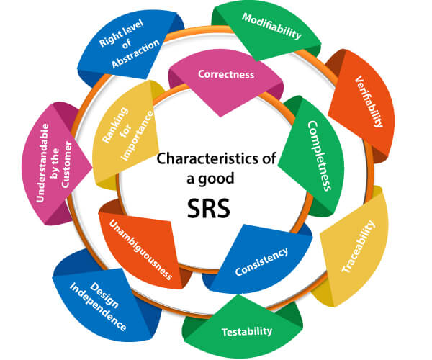
Characteristics of good SRS :

Slide 3
Following are the features of a good SRS document:
1. Correctness: User review is used to provide the accuracy of requirements stated in the SRS. SRS is said to be perfect if it covers all the needs that are truly expected from the system.
2. Completeness: The SRS is complete if, and only if, it includes the following elements:
(1). All essential requirements, whether relating to functionality, performance, design, constraints, attributes, or external interfaces.
(2). Definition of their responses of the software to all realizable classes of input data in all available categories of situations.
(3). Full labels and references to all figures, tables, and diagrams in the SRS and definitions of all terms and units of measure.
3. Consistency: The SRS is consistent if, and only if, no subset of individual requirements described in its conflict. There are three types of possible conflict in the SRS:

Slide 4
(1). The specified characteristics of real-world objects may conflicts. For example,
(a) The format of an output report may be described in one requirement as tabular but in another as textual.
(b) One condition may state that all lights shall be green while another states that all lights shall be blue.
(2). There may be a reasonable or temporal conflict between the two specified actions. For example,
(a) One requirement may determine that the program will add two inputs, and another may determine that the program will multiply them.
(b) One condition may state that "A" must always follow "B," while other requires that "A and B" co-occurs.
(3). Two or more requirements may define the same real-world object but use different terms for that object. For example, a program's request for user input may be called a "prompt" in one requirement's and a "cue" in another. The use of standard terminology and descriptions promotes consistency.

Slide 5
4. Unambiguousness: SRS is unambiguous when every fixed requirement has only one interpretation. This suggests that each element is uniquely interpreted. In case there is a method used with multiple definitions, the requirements report should determine the implications in the SRS so that it is clear and simple to understand.
5. Ranking for importance and stability: The SRS is ranked for importance and stability if each requirement in it has an identifier to indicate either the significance or stability of that particular requirement.
Typically, all requirements are not equally important. Some prerequisites may be essential, especially for life-critical applications, while others may be desirable. Each element should be identified to make these differences clear and explicit. Another way to rank requirements is to distinguish classes of items as essential, conditional, and optional.
6. Modifiability: SRS should be made as modifiable as likely and should be capable of quickly obtain changes to the system to some extent. Modifications should be perfectly indexed and cross-referenced.
7. Verifiability: SRS is correct when the specified requirements can be verified with a cost-effective system to check whether the final software meets those requirements. The requirements are verified with the help of reviews.
8. Traceability: The SRS is traceable if the origin of each of the requirements is clear and if it facilitates the referencing of each condition in future development or enhancement documentation.

Slide 6
There are two types of Traceability:
1. Backward Traceability: This depends upon each requirement explicitly referencing its source in earlier documents.
2. Forward Traceability: This depends upon each element in the SRS having a unique name or reference number.
The forward traceability of the SRS is especially crucial when the software product enters the operation and maintenance phase. As code and design document is modified, it is necessary to be able to ascertain the complete set of requirements that may be concerned by those modifications.
9. Design Independence: There should be an option to select from multiple design alternatives for the final system. More specifically, the SRS should not contain any implementation details.
10. Testability: An SRS should be written in such a method that it is simple to generate test cases and test plans from the report.
11. Understandable by the customer: An end user may be an expert in his/her explicit domain but might not be trained in computer science. Hence, the purpose of formal notations and symbols should be avoided too as much extent as possible. The language should be kept simple and clear.
12. The right level of abstraction: If the SRS is written for the requirements stage, the details should be explained explicitly. Whereas, for a feasibility study, fewer analysis can be used. Hence, the level of abstraction modifies according to the objective of the SRS.

Slide 7
Properties of a good SRS document
The essential properties of a good SRS document are the following:
Concise: The SRS report should be concise and at the same time, unambiguous, consistent, and complete. Verbose and irrelevant descriptions decrease readability and also increase error possibilities.
Structured: It should be well-structured. A well-structured document is simple to understand and modify. In practice, the SRS document undergoes several revisions to cope up with the user requirements. Often, user requirements evolve over a period of time. Therefore, to make the modifications to the SRS document easy, it is vital to make the report well-structured.
Black-box View: It should only define what the system should do and refrain from stating how to do these. This means that the SRS document should define the external behavior of the system and not discuss the implementation issues. The SRS report should view the system to be developed as a black box and should define the externally visible behavior of the system. For this reason, the SRS report is also known as the black-box specification of a system.

Slide 8
Conceptual Integrity: It should show conceptual integrity so that the reader can merely understand it. Response to undesired events: It should characterize acceptable responses to unwanted events. These are called system response to exceptional conditions.
Verifiable: All requirements of the system, as documented in the SRS document, should be correct. This means that it should be possible to decide whether or not requirements have been met in an implementation.
Requirements Analysis :
Requirement analysis is significant and essential activity after elicitation. We analyze, refine, and scrutinize the gathered requirements to make consistent and unambiguous requirements. This activity reviews all requirements and may provide a graphical view of the entire system. After the completion of the analysis, it is expected that the understandability of the project may improve significantly. Here, we may also use the interaction with the customer to clarify points of confusion and to understand which requirements are more important than others.

Slide 9
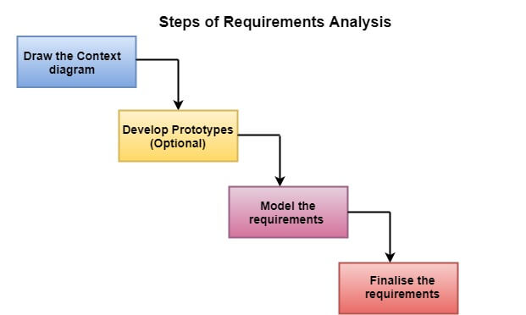
The various steps of requirement analysis are shown in fig:

Slide 10
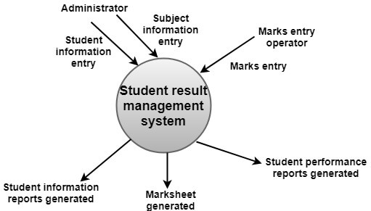
Draw the context diagram: The context diagram is a simple model that defines the boundaries and interfaces of the proposed systems with the external world. It identifies the entities outside the proposed system that interact with the system. The context diagram of student result management system is given below:

Slide 11
(ii) Development of a Prototype (optional): One effective way to find out what the customer wants is to construct a prototype, something that looks and preferably acts as part of the system they say they want.
We can use their feedback to modify the prototype until the customer is satisfied continuously. Hence, the prototype helps the client to visualize the proposed system and increase the understanding of the requirements. When developers and users are not sure about some of the elements, a prototype may help both the parties to take a final decision.
Some projects are developed for the general market. In such cases, the prototype should be shown to some representative sample of the population of potential purchasers. Even though a person who tries out a prototype may not buy the final system, but their feedback may allow us to make the product more attractive to others.
The prototype should be built quickly and at a relatively low cost. Hence it will always have limitations and would not be acceptable in the final system. This is an optional activity.

Slide 12
(iii) Model the requirements: This process usually consists of various graphical representations of the functions, data entities, external entities, and the relationships between them. The graphical view may help to find incorrect, inconsistent, missing, and superfluous requirements. Such models include the data flow diagram, entity-relationship diagram, data dictionaries, state-transition diagrams, etc.
(iv) Finalise the requirements: After modeling the requirements, we will have a better understanding of the system behavior. The inconsistencies and ambiguities have been identified and corrected. the flow of data amongst various modules has been analysed. Elicitation and analyze activities have provided better insight into the system. now we finalize the analysed requirements, and the next step is to document these requirements in a prescribed format.

Slide 13
Data Flow Diagrams
A Data Flow Diagram (DFD) is a traditional visual representation of the information flows within a system. A neat and clear DFD can depict the right amount of the system requirement graphically. It can be manual, automated, or a combination of both.
It shows how data enters and leaves the system, what changes the information, and where data is stored.
The objective of a DFD is to show the scope and boundaries of a system as a whole. It may be used as a communication tool between a system analyst and any person who plays a part in the order that acts as a starting point for redesigning a system. The DFD is also called as a data flow graph or bubble chart.

Slide 14
The following observations about DFDs are essential:
All names should be unique. this makes it easier to refer to elements in the DFD.
2. Remember that DFD is not a flow chart. arrows is a flow chart that represents the order of events; arrows in DFD represents flowing data. a DFD does not involve any order of events.
3. Suppress logical decisions. if we ever have the urge to draw a diamond-shaped box in a DFD, suppress that urge! a diamond-shaped box is used in flow charts to represents decision points with multiple exists paths of which the only one is taken. this implies an ordering of events, which makes no sense in a DFD.
4. Do not become bogged down with details. defer error conditions and error handling until the end of the analysis.

Slide 15
Standard symbols for DFDs are derived from the electric circuit diagram analysis and are shown in fig:

Slide 16
MEANING OF SYMBOLS USED IN DATA FLOW DIAGRAMS:
1. Circle: A circle (bubble) shows a process that transforms data inputs into data outputs.
2. Data Flow: A curved line shows the flow of data into or out of a process or data store.
3. Data Store: A set of parallel lines shows a place for the collection of data items. a data store indicates that the data is stored which can be used at a later stage or by the other processes in a different order. the data store can have an element or group of elements.
4. Source or Sink: Source or Sink is an external entity and acts as a source of system inputs or sink of system outputs.

Slide 17
Levels in Data Flow Diagrams (DFD)
The DFD may be used to perform a system or software at any level of abstraction. Infact, dfds may be partitioned into levels that represent increasing information flow and functional detail. levels in DFD are numbered 0, 1, 2 or beyond. here, we will see primarily three levels in the data flow diagram, which are: 0-level DFD, 1-level DFD, and 2-level DFD.
1. 0-level DFDM
It is also known as fundamental system model, or context diagram represents the entire software requirement as a single bubble with input and output data denoted by incoming and outgoing arrows. Then the system is decomposed and described as a DFD with multiple bubbles. Parts of the system represented by each of these bubbles are then decomposed and documented as more and more detailed DFDs.
This process may be repeated at as many levels as necessary until the program at hand is well understood. It is essential to preserve the number of inputs and outputs between levels, this concept is called leveling by DeMacro. Thus, if bubble "A" has two inputs x1 and x2 and one output y, then the expanded DFD, that represents "A" should have exactly two external inputs and one external output as shown in fig:

Slide 18
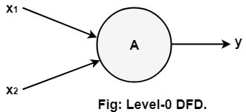
The level-0 DFD, also called context diagram of the result management system is shown in fig. as the bubbles are decomposed into less and less abstract bubbles, the corresponding data flow may also be needed to be decomposed.

Slide 19
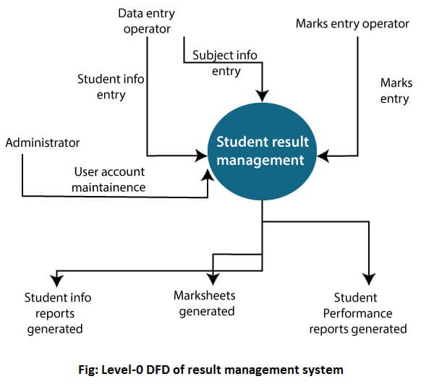

Slide 20
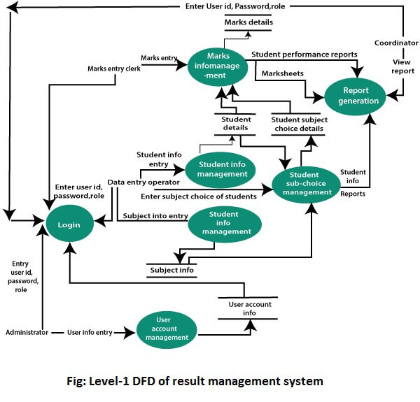
1-level DFD
In 1-level DFD, a context diagram is decomposed into multiple bubbles/processes. In this level, we highlight the main objectives of the system and breakdown the high-level process of 0-level DFD into subprocesses.

Slide 21
2-Level DFD
2-level DFD goes one process deeper into parts of 1-level DFD. It can be used to project or record the specific/necessary detail about the system's functioning.

Slide 23
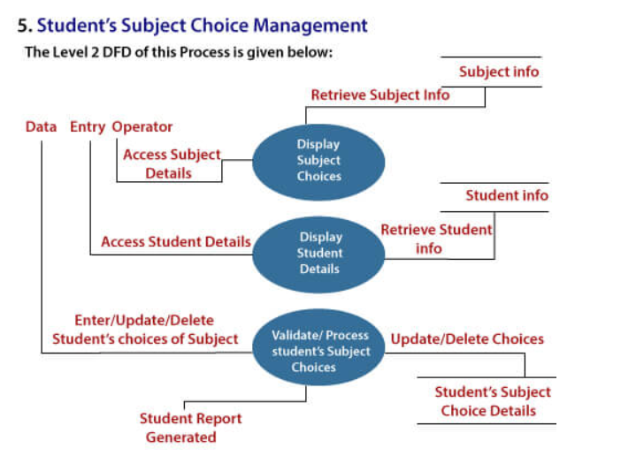

Slide 25
QUESTIONS :
1. Which of the following is not a diagram studied in requirement analysis ?
a) Use cases
b) Entity relationship diagram
c) State transition diagram
d) Activity diagram
2. How many feasibility studies is conducted in Requirement Analysis ?
a) Two
b) Three
c) Four
d) None of the mentioned
3. How many phases are there in Requirement Analysis ?
a) Three
b) Four
c) Five
d) Six

Slide 26
Questions :
4. SRS consists of?
a.) problem statement
b.) product design
c.) problem statement & product design
d.) none of the mentioned
5. Requirements should specify ‘what’ but not ‘how’.
a) True
b) False
6. The requirements that result from requirements analysis are typically expressed from one of three perspectives or views. What is that perspective or view ?
a) Developer
b) User
c) Non-Functional
d) Physical

